Slide 1
Savitribai Phule Pune University
Jaihind College of Engineering
Operating System
Fundamental concept of Operating system
Prof:-Buttepatil.S.S

Slide 2
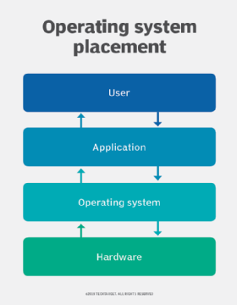
Operating System
An operating system is a program that controls the execution of application programs and acts as an interface between the user of a computer and the computer hardware.Some examples of operating systems include Apple macOS, Microsoft Windows, Google's Android OS, Linux Operating System, and Apple iOS

Slide 3
What is an Operating System?
Computer System = Hardware + Software
Software = Application Software + System Software(OS)
An Operating System is a system Software that acts as an intermediary/interface between a user of a computer and the computer hardware.
Operating system goals:
  Execute user programs and make solving user problems easier
  Make the computer system convenient to use
  Use the computer hardware in an efficient manner

Slide 4
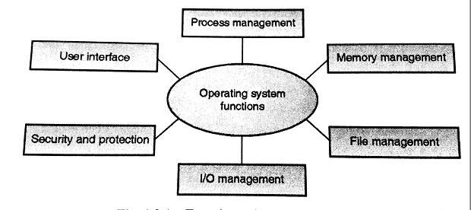
Functions of Operating System

Slide 5
1. Process Management
A process is a program in execution.
A process needs certain resources, including CPU time, memory, files, and I/O devices to accomplish its task. Simultaneous execution leads to multiple processes. Hence creation, execution and termination of a process are the most basic functionality of an OS If processes are dependent, than they may try to share same resources. thus task of process synchronization comes to the picture. If processes are independent, than a due care needs to be taken to avoid their overlapping in memory area. Based on priority, it is important to allow more important processes to execute first than others.

Slide 6
2. Memory management
Memory is a large array of words or bytes, each with its own address.
It is a repository of quickly accessible data shared by the CPU and I/O devices.
Main memory is a volatile storage device. When the computer made turn off everything stored in RAM will be erased automatically.
In addition to the physical RAM installed in your computer, most modern operating systems allow your computer to use a virtual memory system. Virtual memory allows your computer to use part of a permanent storage device (such as a hard disk) as extra memory.
The operating system is responsible for the following activities in connections with memory management:
  Keep track of which parts of memory are currently being used and by whom.
  Decide which processes to load when memory space becomes available.
  Allocate and de-allocate memory space as needed.

Slide 7
3. File Management
A file is a collection of related information defined by its creator.
The operating system is responsible for the following activities in connections with file management:
  ✦ File creation and deletion.
  ✦ Directory creation and deletion.
  ✦ Support of primitives for manipulating files and directories.
  ✦ Mapping files onto secondary storage.
  ✦ File backup on stable (nonvolatile) storage media.

Slide 8
4. Device Management or I/O Management
Device controllers are components on the motherboard (or on expansion cards) that act as an interface between the CPU and the actual device.
Device drivers, which are the operating system software components that interact with the devices controllers.
A special device (inside CPU) called the Interrupt Controller handles the task of receiving interrupt requests and prioritizes them to be forwarded to the processor.
Deadlocks can occur when two (or more) processes have control of different I/O resources that are needed by the other processes, and they are unwilling to give up control of the device.
It performs the following activities for device management.
  Keeps tracks of all devices connected to system.
  Designates a program responsible for every device known as Input/output controller.
  Decides which process gets access to a certain device and for how long.
  Allocates devices in an effective and efficient way.
  Deallocates devices when they are no longer required.

Slide 9
5. Security & Protection
The operating system uses password protection to protect user data and similar other techniques.
It also prevents unauthorized access to programs and user data by assigning access right permission to files and directories.
The owners of information stored in a multiuser or networked computer system may want to control use of that information, concurrent processes should not interfere with each other.

Slide 10
6. User Interface Mechanism
A user interface (UI) controls how you enter data and instructions and how information is displayed on the screen
There are two types of user interfaces
  Command Line Interface
  Graphical user Interface

Slide 11
Operating System Objectives
Convenience
  Makes the computer more convenient to use
Efficiency
  Allows computer system resources to be used in an efficient manner
Ability to evolve
  Permit effective development, testing, and introduction of new system functions without interfering with service

Slide 12
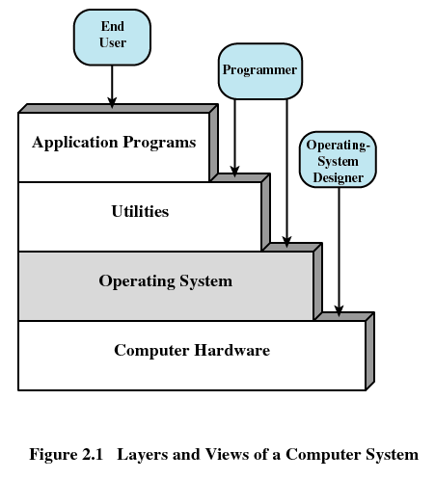
Layers of Computer System

Slide 13
Services Provided by the Operating System
Program development
  Editors and debuggers
  Application program development tools
Program execution
-- Instructions and data must be loaded into memory
-- I/O devices and files must be initialized
Handling I/O Operations:
-- Each I/O device requires its own peculiar set of instructions.
-- O.S provides a uniform interface that hides these
Manipulationn of files system:
-- O.S must reflect detailed understanding of the nature of the I/O device
-- the structure of the data contained in the files on the storage medium
System access
-- For shared systems , the O.S controls assess to the system as a whole and to specific system resources.

Slide 14
Services Provided by the Operating System
Error detection and response
  Internal and external hardware errors
    Memory error
    Device failure
  Software errors
    Arithmetic overflow
    Access forbidden memory locations
  Operating system cannot grant request of application

Slide 15
Services Provided by the Operating System
Accounting
  Collect usage statistics
  Monitor performance
  Used to anticipate future enhancements
  Used for billing purposes
  Communication:Many times it is needed that one process needs to exchange information with another process,a very simple example is copy from one program and paste it in another program this program under execution is a process

Slide 16
History of Operating System
The First Generation (1940's to early 1950's)
  No Operating System Hardware like Vacuum tubes and plug board were used
  No protection
  All programming was done in absolute machine language, often by wiring up plug-boards to control the machine’s basic functions.
The Second Generation (1955-1965)
  First operating system was introduced in the early 1950's.
  Created by General Motors for IBM's machine the 701.
  Single-stream batch processing systems

Slide 17
ransistors used,assembly language used
The Third Generation (1965-1980)
IC is used ,Introduction of multiprogramming
Intergrated circuit(IC)
The Fourth Generation (1980-Present Day)(large scale integration circuits)
Used it containing thousand of transistor are used in these system.
.used multi threading ,scheduling and pipelining concept are introduced
The Fifth Generation (Present and Further)( (It use artificial intelligense circuits)

Slide 18
Types of Operating Systems
Batch Operating System-
Time-Sharing OS-
Distributed OS-
Network OS-
Real Time OS-

Slide 19
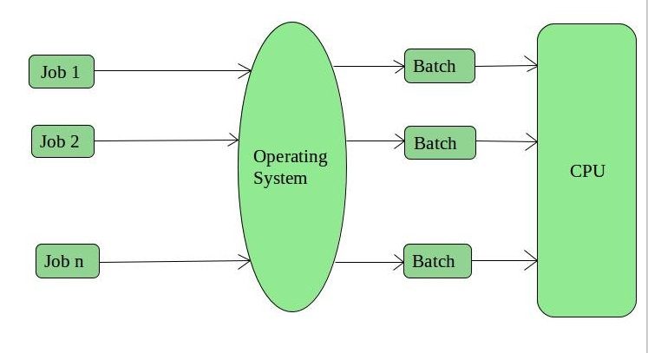
1. Batch Operating System
The users of this type of operating system does not interact with the computer directly.
Each user prepares his job on an off-line device like punch cards and submits it to the computer operator
There is an operator which takes similar jobs having the same requirement and group them into batches.

Slide 20
1. Batch Operating System cont..
Advantages of Batch Operating System:
  Processors of the batch systems know how long the job would be when it is in queue
  Multiple users can share the batch systems
  The idle time for the batch system is very less
  It is easy to manage large work repeatedly in batch systems
Disadvantages of Batch Operating System:
  The computer operators should be well known with batch systems
  Batch systems are hard to debug
  It is sometimes costly

Slide 21
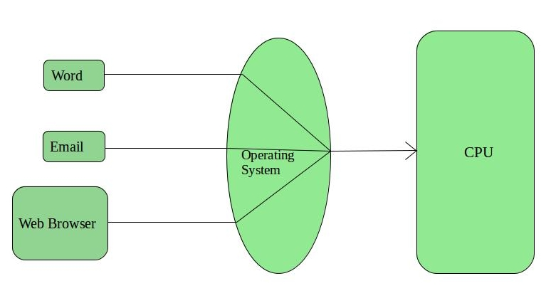
2. Time-Sharing Operating Systems
Each task is given some time to execute so that all the tasks work smoothly.These systems are also known as Multi-tasking Systems.
The task can be from a single user or different users also.The time that each task gets to execute is called quantum.After this time interval is over OS switches over to the next task.

Slide 22
2. Time-Sharing Operating Systems cont..
Advantages of Time-Sharing OS:
  Each task gets an equal opportunity
  Fewer chances of duplication of software
  CPU idle time can be reduced
Disadvantages of Time-Sharing OS:
  Reliability problem
  One must have to take care of the security and integrity of user programs and data
  Data communication problem
Examples of Time-Sharing Oss
    Multics, Unix, etc.

Slide 23
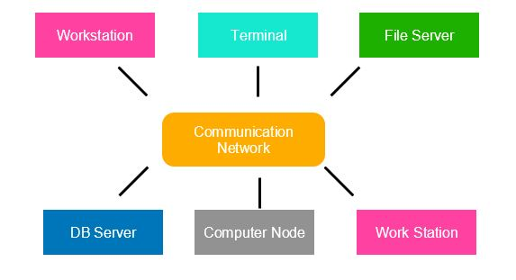
3. Distributed Operating System
Various autonomous interconnected computers communicate with each other using a shared communication network.
Independent systems possess their own memory unit and CPU.
These are referred to as loosely coupled systems.
Examples:- Locus, DYSEAC

Slide 24
4. Network Operating System
These systems run on a server and provide the capability to manage data, users, groups, security, applications, and other networking functions.
These types of operating systems allow shared access of files, printers, security, applications, and other networking functions over a small private network.
The “ other" computers arc called client computers, and each computer that connects to a network server must be running client software designed to request a specific service.
popularly known as tightly coupled systems.

Slide 25
4. Network Operating System
Advantages of Network Operating System:
Highly stable centralized servers
Security concerns are handled through servers
New technologies and hardware up-gradation are easily integrated into the system
Server access is possible remotely from different locations and types of systems

Slide 26
Disadvantages of Network Operating System:
Servers are costly
User has to depend on a central location for most operations
Maintenance and updates are required regularly
Examples of Network Operating System are:
Microsoft Windows Server 2003/2008/2012, UNIX, Linux, Mac OS X, Novell NetWare, and BSD, etc.

Slide 27
4. Real time Operating System
These types of OSs serve real-time systems.
The time interval required to process and respond to inputs is very small.
This time interval is called response time.
Real-time systems are used when there are time requirements that are
very strict like.
air traffic control systems.
Two Types:1)Hard real time system.
2)soft real time system.

Slide 28
Operating System Design Issues
There are various types of Advanced Operating Systems. Though all the Major Design Issues will be applicable to most of the Operating Systems.
The important issues related to Operating system are
Transparency 9.security:
flexibility
Reliability
performance
scalability
naming
replication
synchronization

Slide 29
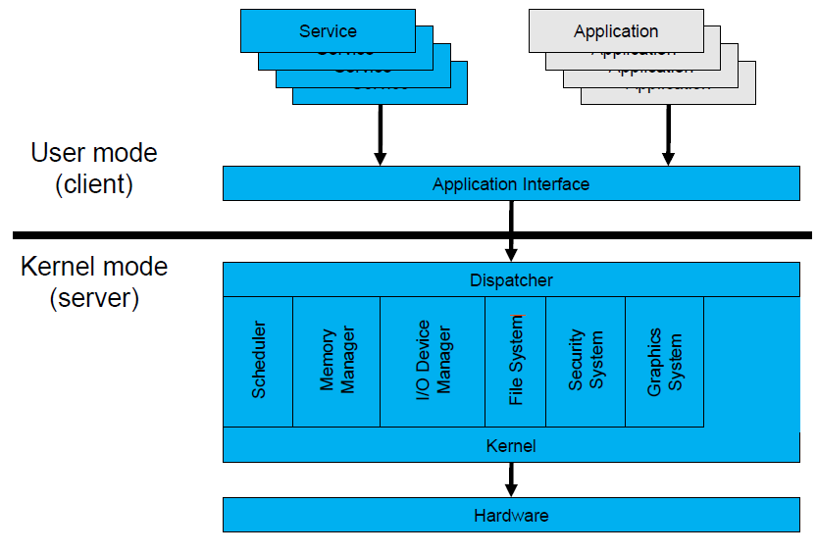
Operating System Mode
The User Mode is concerned with the actual interface between the user and the system.
It controls things like running applications and accessing files.
The Kernel Mode is concerned with everything running in the background.
System calls are used to change mode from User to Kernel.

Slide 30
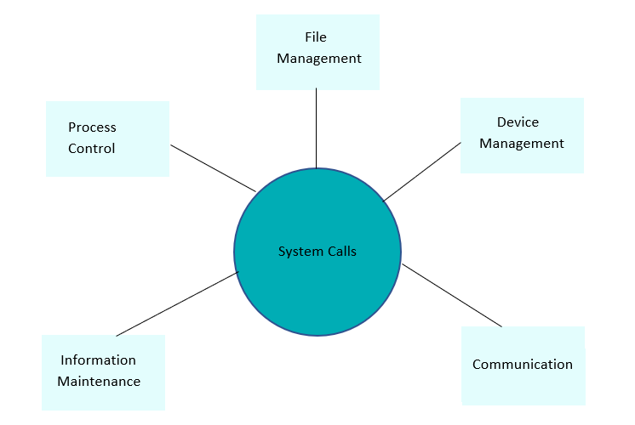
System Call
A system call is a procedure that provides the interface between a process and the operating system. It is the way by which a computer program requests a service from the kernel of the operating system.

Slide 31
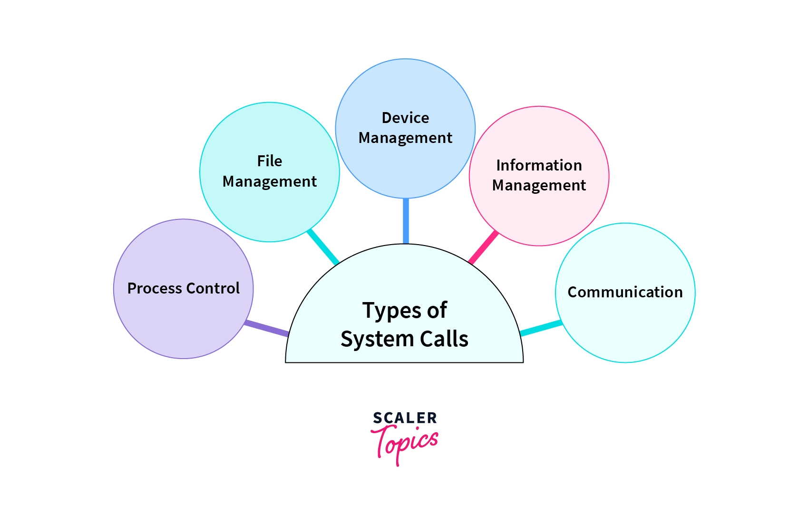

Slide 32
Process Control :
fork()
  A new process is created by the fork() system call.
  A new process may be created with fork() without a new program being run-the new sub-process simply continues to execute exactly the same program that the first (parent) process was running.
  It is one of the most widely used system calls under process management.
exit()
  The exit() system call is used by a program to terminate its execution.
  The operating system reclaims resources that were used by the process after the exit() system call.

Slide 33
exec()
A new program will start executing after a call to exec()
Running a new program does not require that a new process be created first: any process may call exec() at any time. The currently running program is immediately terminated, and the new program starts executing in the context of the existing process.

Slide 34
File Management :
open():
  It is the system call to open a file.
  This system call just opens the file, to perform operations such as read and write, we need to execute different system call to perform the operations.
read():
  This system call opens the file in reading mode
  We can not edit the files with this system call.
  Multiple processes can execute the read() system call on the same file simultaneously.
write():
  This system call opens the file in writing mode
Close():
This system call closes the opened file

Slide 35
Information Maintenance:
getpid():
  getpid stands for Get the Process ID.
  The getpid() function shall return the process ID of the calling process
alarm():
  This system call sets an alarm clock for the delivery of a signal that when it has to be reached.
  It arranges for a signal to be delivered to the calling process.
sleep():
  This System call suspends the execution of the currently running process for some interval of time.

Slide 36
Device Management :
Device management does the job of device manipulation like reading from device buffers, writing into device buffers, etc. The Linux System calls under this is ioctl().
ioctl():
  ioctl() is referred to as Input and Output Control.
  ioctl is a system call for device-specific input/output operations and other operations which cannot be expressed by regular system calls.

Slide 37
Communication :
pipe():
  The pipe() system call is used to communicate between different Linux processes.
  It is mainly used for inter-process communication.
  The pipe() system function is used to open file descriptors.
shmget():
  shmget stands for shared memory segment.
  It is mainly used for Shared memory communication.
  This system call is used to access the shared memory and access the messages in order to communicate with the process.
mmap():
  This function call is used to map or unmap files or devices into memory.
  The mmap() system call is responsible for mapping the content of the file to the virtual memory space of the process.

Slide 38
Shell Scripting
A shell is special user program which provide an interface to user to use operating system services. Shell accept human readable commands from user and convert them into something which kernel can understand. It is a command language interpreter that execute commands read from input devices such as keyboards or from files. The shell gets started when the user logs in or start the terminal.
The prompt, $, which is called the command prompt, is issued by the shell. While the prompt is displayed, you can type a command.

Slide 39
Shell Types
In Unix, there are two major types of shells −
Bourne shell − If you are using a Bourne-type shell, the $ character is the default prompt.
C shell − If you are using a C-type shell, the % character is the default prompt.
The basic concept of a shell script is a list of commands, which are listed in the order of execution. A good shell script will have comments, preceded by # sign, describing the steps.
There are conditional tests, such as value A is greater than value B, loops allowing us to go through massive amounts of data, files to read and store data, and variables to read and store data, and the script may include functions.

Slide 40
Shell command
A shell is special user program which provide an interface to user to use operating system services. Shell accept human readable commands from user and convert them into something which kernel can understand.
ls-it is used list information about files and directories within the file system.
Cd- change directories.
Mkdir -make directories
rm-remove
Date -
Pwd-
Cal-

Slide 41
Shell command
Sort-sort is a simple and very useful command which will rearrange the lines in a text file so that they are sorted numerically and alphabetically
Grip-perform similar operations.
Clear-clear screen or window for a fresh start.
Touch-create a empty file with the specific name.
Prof:-Buttepatil.S.S

